Slide 1
scRNA-seq Analysis
CDS-SR scRNA-seq Workshop 2022
(Section 1)
Seurat (Cell Annotations)
Slide 1

Slide 2
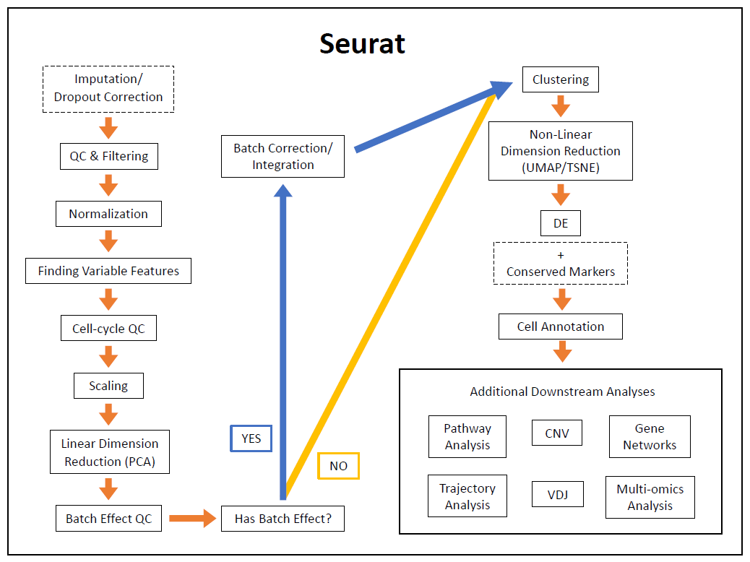
Slide 2

Slide 3
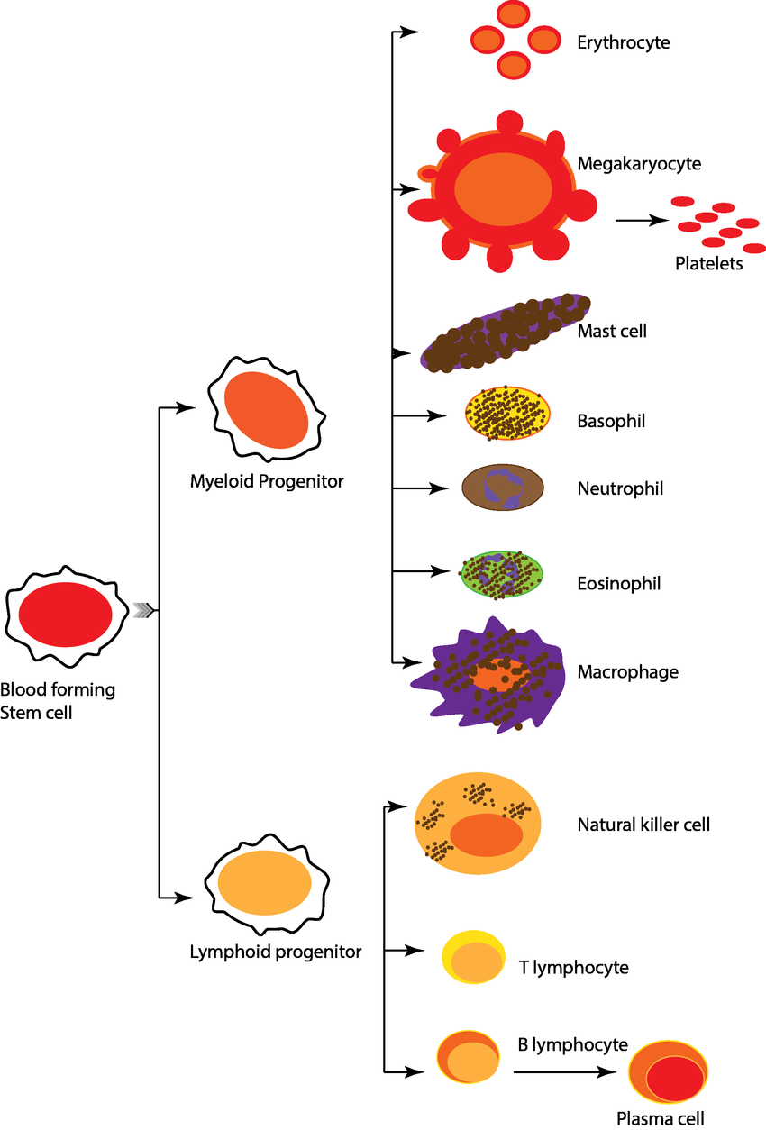
Cell Annotations
Define clusters as cell types
Subjective process
Many ways to do this
Main thing to consider:
Gene markers
T-cells = CD3+
Helper = CD4+CD8-
Cytotoxic = CD4-CD8+
NK = CD3-
Can express CD8
https://www.researchgate.net/figure/Different-blood-cell-types-and-their-origin_fig1_331791259
Slide 3
Notes:
Read first bullet point
Read second major bullet points
Don’t feel bad if have different way of doing this
Show how I do it and some pointers
Read third major bullet points

Slide 4
Cell Annotations
Where do I start with annotating my clusters?
Curate a markers list
Custom list
Based on experience of previous datasets and articles
Databases
Human Protein, CellMarker, PanglaoDB, celldex (in SingleR package), etc.
Be wary of cell types that are organ-specific
Acinar, neurons, osteocytes, muscle, etc.
Slide 4

Slide 5
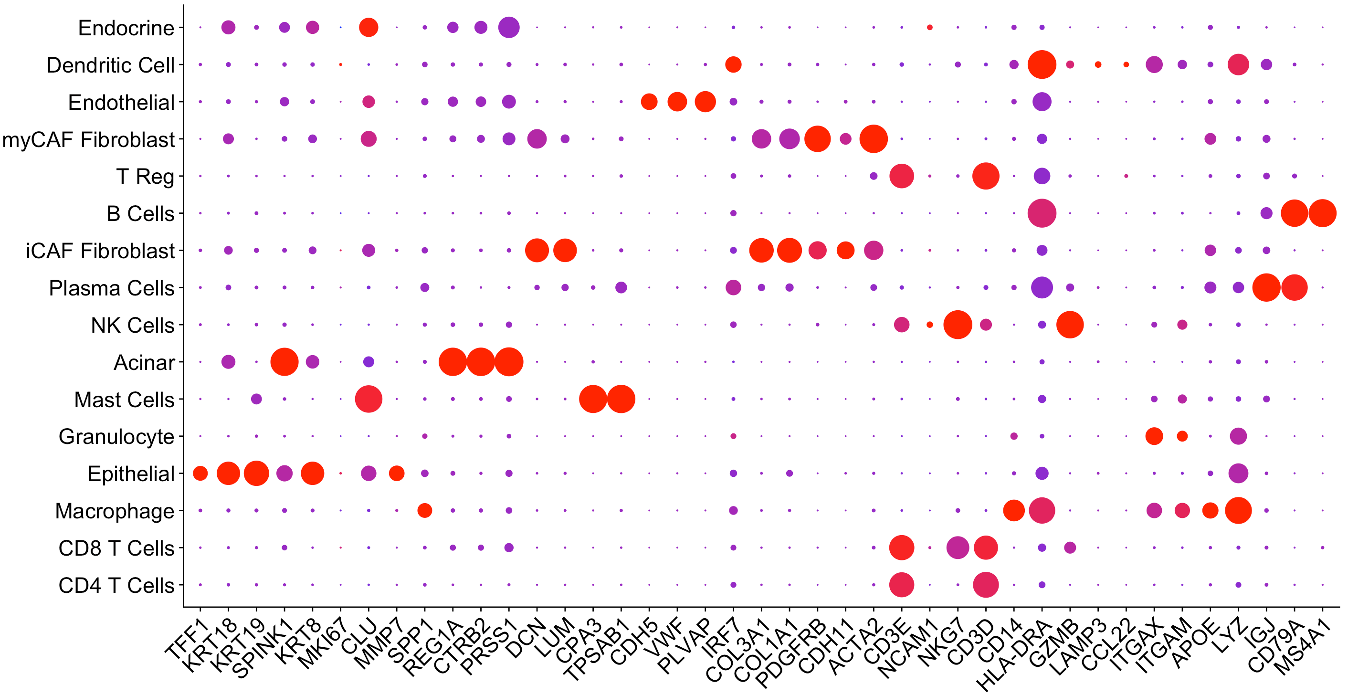





Cell Annotations
Markers used from article
Cell type labels I will use for these next few slides:
Epithelial
Acinar
Endocrine
Endothelial
Myeloid (mast, granulocyte, macrophage)
DC (dendritic cell)
T (CD4 T, T Reg, CD8 T)
NK
B (B/plasma cell)
Fibroblasts (iCAF, myCAF)
Mean expression
MIN
MAX
Percent expressing
https://doi.org/10.1038/s43018-020-00121-4
Slide 5
Notes:
Explain plot on right
help in annotating clusters for this example
Go through what labels I will use in this example

Slide 6
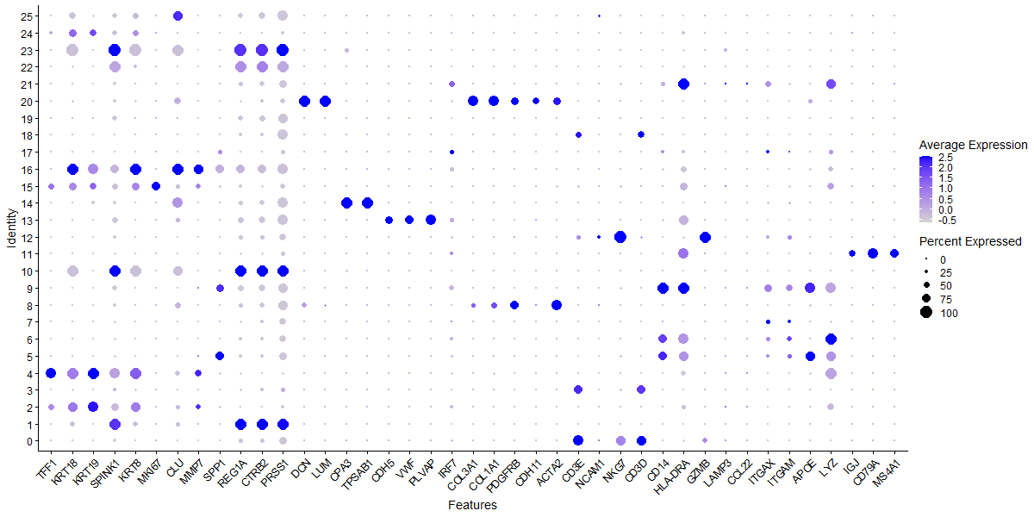
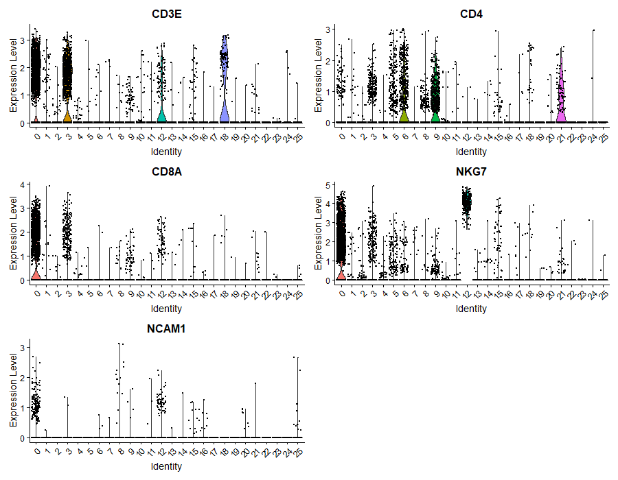
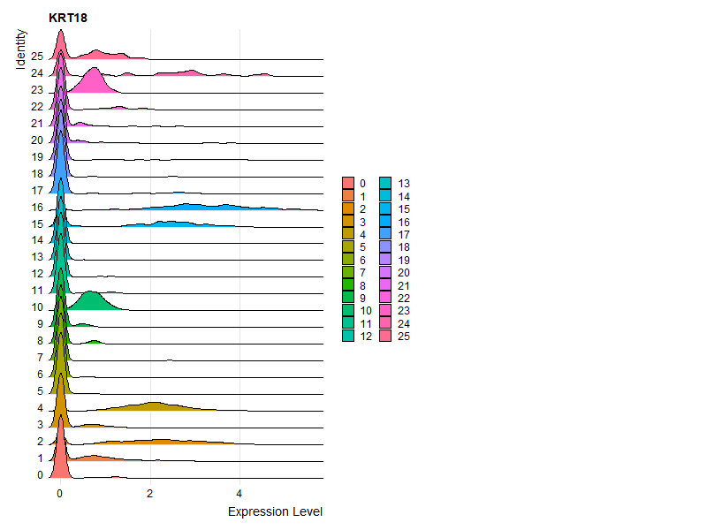
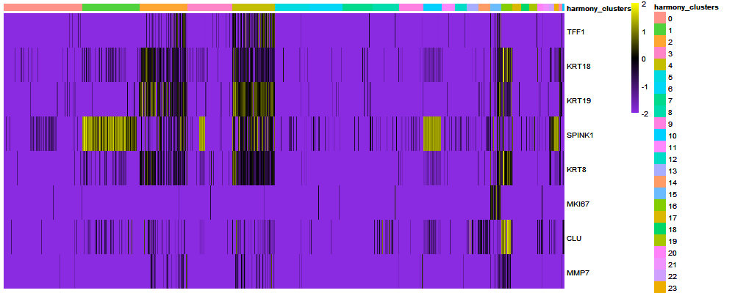
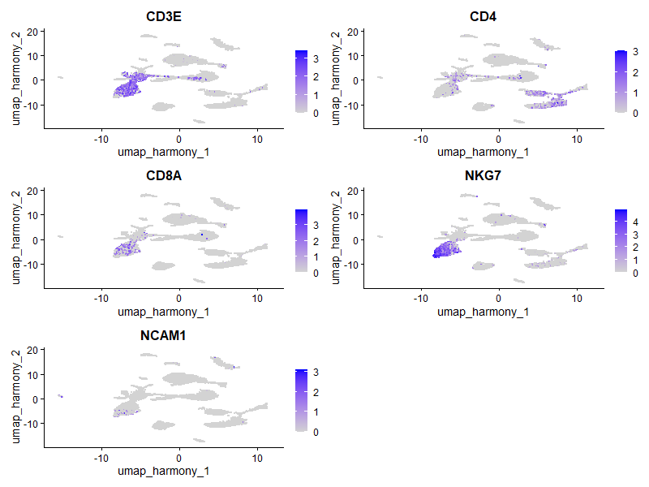
Cell Annotations
Where do I start with annotating my clusters?
Look at expression plots
FeaturePlot, DotPlot, VlnPlot, RidgePlot, heatmaps, etc.
Slide 6
Notes:
Read all bullet points

Slide 7
Cell Annotations
What cell type is cluster 0?
Slide 7
Notes:
Explain plot (dot)
contains genes from articles
clusters from harmony integration
Show how to annotate cluster 0

Slide 8
Cell Annotations
What cell type is cluster 0?
Expresses CD3E, CD3D, and NKG7
T-cell cluster
But is it CD4, CD8, or some other subtype of T-cells?
Slide 8
Notes:
Read text

Slide 9
Cell Annotations
What cell type is cluster 0?
Slide 9
Notes:
Look at a few other plots
Explain left plot
Explain right plot

Slide 10
Cell Annotations
It’s not a CD4 T cell (I didn’t show it, but trust me it’s not!)
It does express CD8A and NKG7! So it’s a CD8 T cell!
What cell type is cluster 0?
Expresses CD8A and NKG7 and doesn’t express CD4
CD8 T-cell cluster
Slide 10
Notes:
Look at a few other plots
Explain left plot
Explain right plot

Slide 11
Cell Annotations
What cell type is cluster 2?
Slide 11
Notes:
Show how to annotate cluster 2
Explain left plot
Explain right plot

Slide 12
Cell Annotations
What cell type is cluster 2?
Expresses KRT18 and other epithelial markers
Epithelial cluster
Slide 12
Notes:
Show how to annotate cluster 2
Explain left plot
Explain right plot

Slide 13
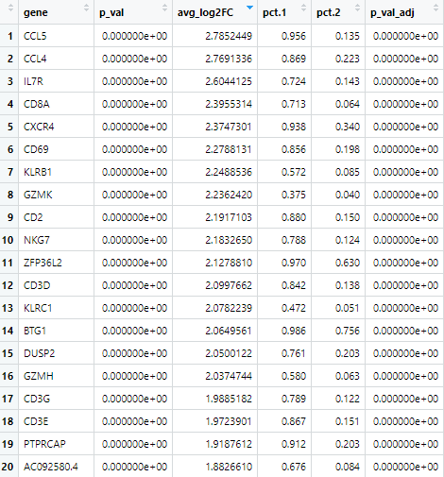
Cell Annotations
Where do I start with annotating my clusters?
Look at DE/Conserved genes
If did DE for clusters
Top genes can give good sense of what markers are expressed if get stuck
Pathway analysis
DE for Cluster 0 (unbatched)
Slide 13
Notes:
Read all bullet points
point out cluster 0 CD8A and CD8B

Slide 14
Cell Annotations
Manual vs. automatic methods
Manual method
Subjective to user
Automatic method
Many of these methods
https://www.nature.com/articles/s41596-021-00534-0
Slide 14
Notes:
Two ways of doing cell annotation
Read all bullet points

Slide 15
Cell Annotations
Manual vs. automatic methods
Automatic method
Example: SingleR
Package in R and a website
Can easily be used with Seurat
Assigns labels to cells based on score based on Spearman rank correlations
Uses only gene markers from reference database (celldex)
Can use custom markers lists
Slide 15
Notes:
Read all bullet points

Slide 16
Cell Annotations
Should I annotate my clusters manually or automatically?
Doing it manually is a must!
Good sanity check especially when using automatic methods
Can be difficult to used automatic methods for more specific subtypes
Ex: fibroblasts
iCAFs, myCAFs, apCAFs
Ideal workflow:
Automatic → Manual → Validation
Slide 16
Notes:
Read all bullet points

Slide 17
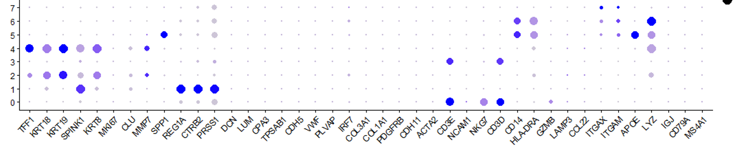
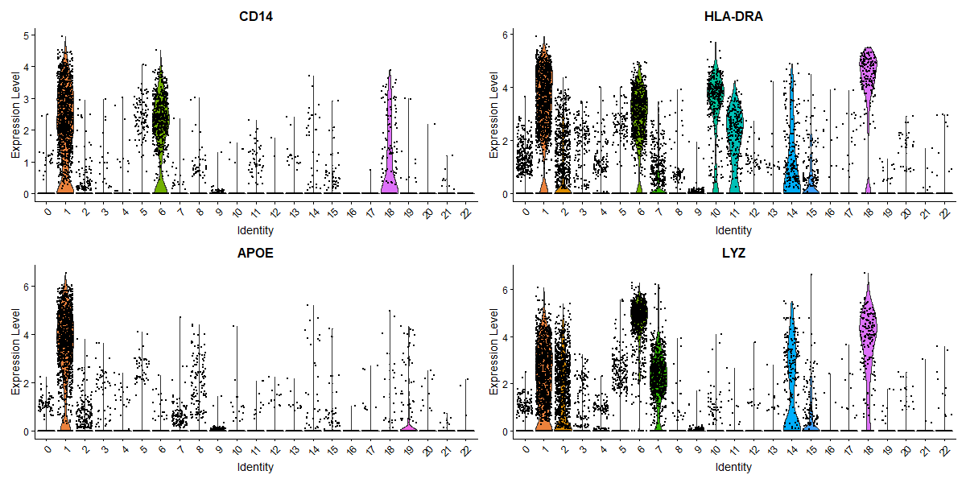
Cell Annotations: Exercise
What is cluster 5 and 6?
Slide 17
Notes:
Annote cluster 1 and 6
suggest open own powerpoint so you can zoom in on the plots as much as you want
highlighted the clusters for the violin plots so you can easily identify them

Slide 18
Cell Annotations: Exercise (Answers)
What is cluster 5 and 6?
Both express CD14 and HLA-DRA → myeloid
Cluster 1 expresses APOE and some LYZ
Cluster 6 express LYZ.
Slide 18
Notes:
Annote cluster 1 and 6
suggest open own powerpoint so you can zoom in on the plots as much as you want
highlighted the clusters for the violin plots so you can easily identify them

Slide 19
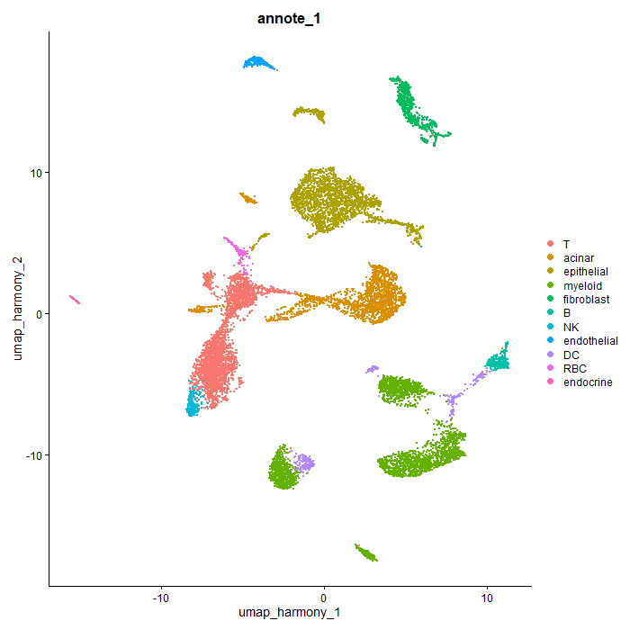

Cell Annotations
Annotated UMAP
Slide 19
Notes:
Read all bullet points

Slide 20
Concluding Remarks on Seurat Pipeline
scRNA-seq can be complicated!
If you have more questions about analysis or this pipeline:
Consult a bioinformatician
Look at the Seurat website
Slide 20

